Slide 1
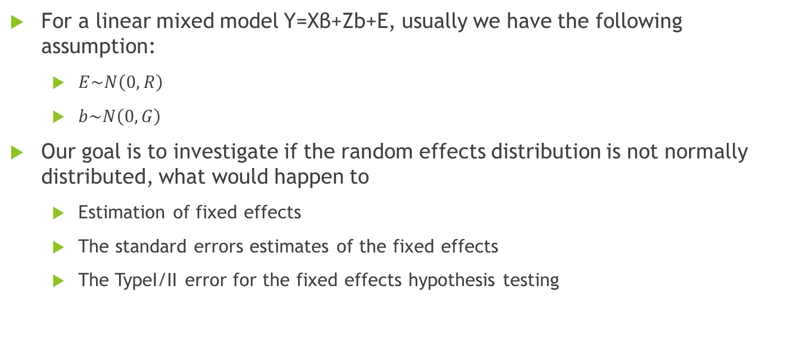
Project2: Linear mixed model with non-normal distribution of random components Speaker: Zhou,Wenru Group3 members: Zhang, Lingdi; Zhuang, Yaxu; Zhou, Wenru
For a linear mixed model Y=Xβ+Zb+E, usually we have the following assumption:
$E\sim N\left(0,R\right)$
$b\sim N\left(0,G\right)$
Our goal is to investigate if the random effects distribution is not normally distributed, what would happen to
Estimation of fixed effects
The standard errors estimates of the fixed effects
The TypeI/II error for the fixed effects hypothesis testing

Slide 2
The case we would study
We take a longitudinal clinical trial dataset for example. Suppose subjects are equally and randomly assigned to a treatment group and a control group. Then they are followed up for several time points. Measurements are collected from each time points.
Dataset:
Number of subjects =20 with 5 and 10 time points per subject.
Number of subjects =200 with 5 and 10 time points per subject.
Number of subjects =1000 with 5 and 10 time points per subject.
Number of dataset in each case is 500.
Model:
Random intercept
Random intercept and slope models.
Fixed components :
Treatment, which indicates treatment or no treatment
Time, which goes from 0 to 4 as integers or 0 to 9 as integers
An interaction between time and treatment
Random components and error distribution:
Error: a independent model error structure.
Random components: a skewed distribution and a mixture distribution.

Slide 3
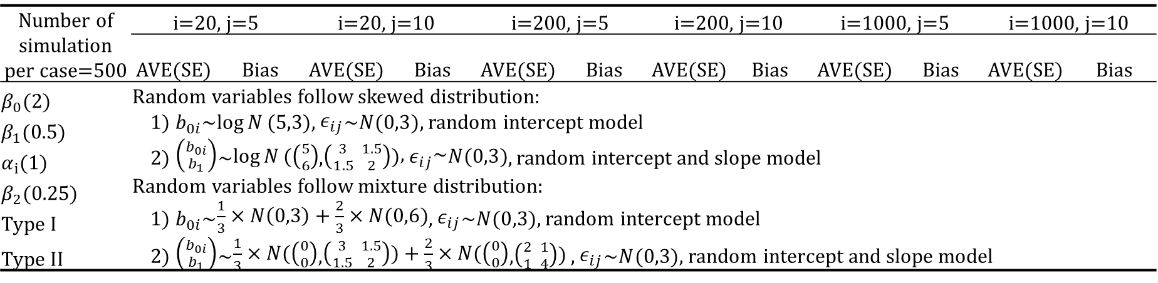
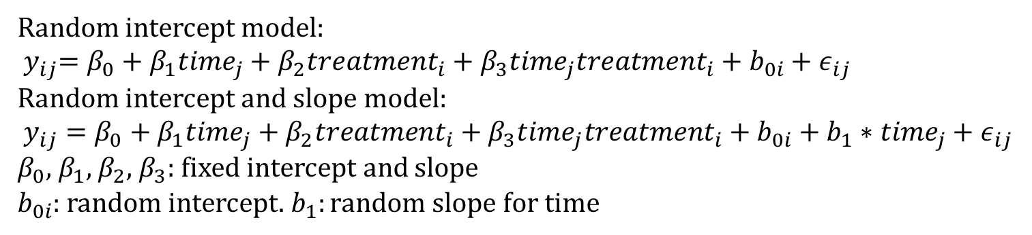
The parameters in the simulation
Random intercept model:
$${ y}_{ij}=β_{0}+β_{1}{time}_{j}+β_{2}{treatment}_{i}+β_{3}{time}_{j}{treatment}_{i}+b_{0i}+ε_{ij}$$
Random intercept and slope model:
$y_{ij}=β_{0}+β_{1}{time}_{j}+β_{2}{treatment}_{i}+β_{3}{time}_{j}{treatment}_{i}+b_{0i}+b_{1}∗{time}_{j}+ε_{ij}$
$β_{0}$, $β_{1}$, $β_{2}$, $β_{3}$: fixed intercept and slope
$b_{0i}$: random intercept. $b_{1}:random slope for time$
Number of simulation per case=500 | i=20, j=5 |  | i=20, j=10 |  |  | i=200, j=5 |  |  | i=200, j=10 |  | i=1000, j=5 |  | i=1000, j=10
 | AVE(SE) | Bias |  | AVE(SE) | Bias |  | AVE(SE) | Bias | AVE(SE) | Bias | AVE(SE) | Bias | AVE(SE) | Bias
$β_{0}$(2) | Random variables follow skewed distribution: 1) $b_{0i}$~$\log{N}(5,3)$, $ε_{ij}$~$N(0,3)$, random intercept model 2) $\left({b_{0i} \atop b_{1}}\right)$~$\log{N}(\left({5 \atop 6}\right)$,$\left({3 \atop 1.5} {1.5 \atop 2}\right))\text{, }ε_{ij}\text{\sim }N(0,3)$, random intercept and slope model Random variables follow mixture distribution: 1) $b_{0i}$~$\frac{1}{3}×N\left(0,3\right)+\frac{2}{3}×N(0,6)$, $ε_{ij}$~$N(0,3)$, random intercept model 2) $\left({b_{0i} \atop b_{1}}\right)$~$\frac{1}{3}×N(\left({0 \atop 0}\right)$,$\left({3 \atop 1.5} {1.5 \atop 2}\right))+\frac{2}{3}×N(\left({0 \atop 0}\right)$,$\left({2 \atop 1} {1 \atop 4}\right))$ , $ε_{ij}$~$N(0,3)$, random intercept and slope model
$β_{1}$(0.5)
$α_{i}$(1)
$β_{2}$(0.25)
Type I
Type II
We will evaluate the output by comparing the true values and the estimated values, SD and SE from mixed modeling

